Slide 1
Unit 5: For Live Session Assignment
Analysis of Variance
(Comparing 3 or more means)

Slide 2
Archeology in New Mexico
An archeological dig in New Mexico yielded four sites with lots of artifacts. The depth (cm) that each artifact was found was recorded along with which site it was found in.
The researcher has reason to believe that sites 1 and 4 and sites 2 and 3 may be similar in age. In theory, the deeper the find, the older the village.
Is there any evidence that sites 1 and 4 have a mean depth that is different than the mean depth of artifacts from sites 2 and 3?

Slide 3
Archaeology Example
Depth | Site |  | Depth | Site |  | Depth | Site |  | Depth | Site
93 | 1 |  | 85 | 2 |  | 100 | 3 |  | 96 | 4
120 | 1 |  | 45 | 2 |  | 75 | 3 |  | 58 | 4
65 | 1 |  | 80 | 2 |  | 65 | 3 |  | 95 | 4
105 | 1 |  | 28 | 2 |  | 40 | 3 |  | 90 | 4
115 | 1 |  | 75 | 2 |  | 73 | 3 |  | 65 | 4
82 | 1 |  | 70 | 2 |  | 65 | 3 |  | 80 | 4
99 | 1 |  | 65 | 2 |  | 50 | 3 |  | 85 | 4
87 | 1 |  | 55 | 2 |  | 30 | 3 |  | 95 | 4
100 | 1 |  | 50 | 2 |  | 45 | 3 |  | 82 | 4
90 | 1 |  | 40 | 2 |  | 50 | 3
78 | 1 |  |  |  |  | 45 | 3
95 | 1 |  |  |  |  | 55 | 3
93 | 1
88 | 1
110 | 1

Slide 4
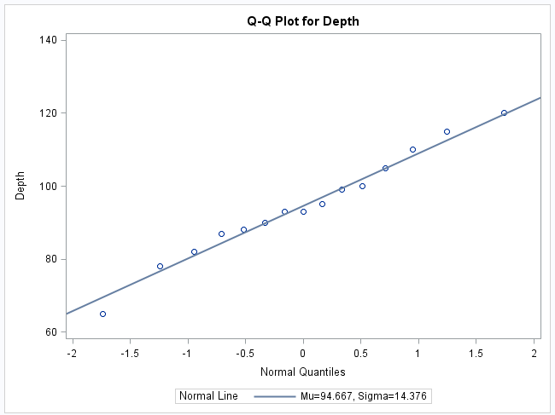
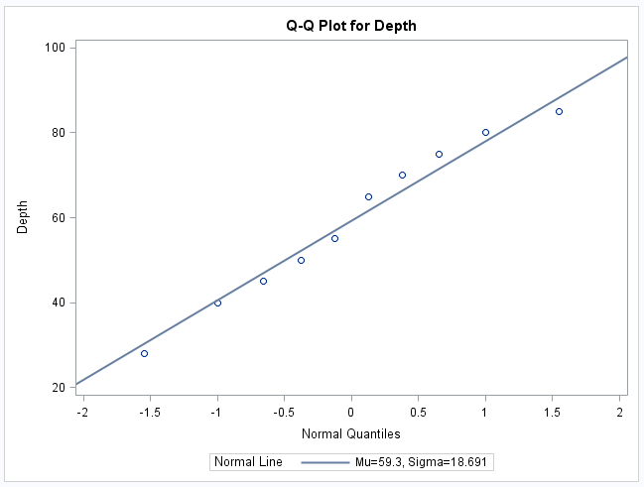
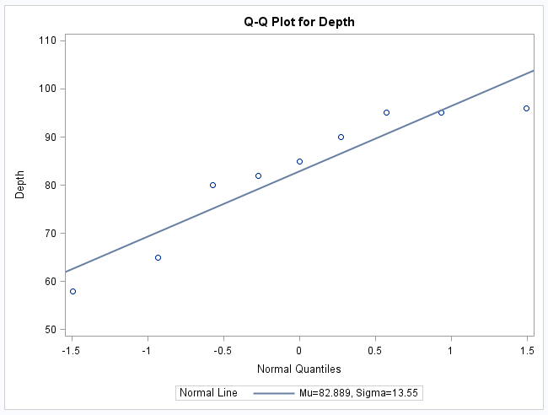
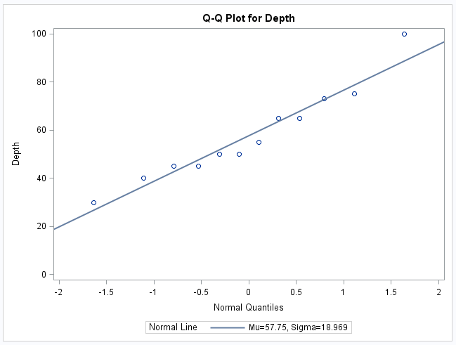
Archeology Example Assumptions: Normality
Site 1
Site 2
Site 4
Site 3
Histograms will be helpful as well!

Slide 5
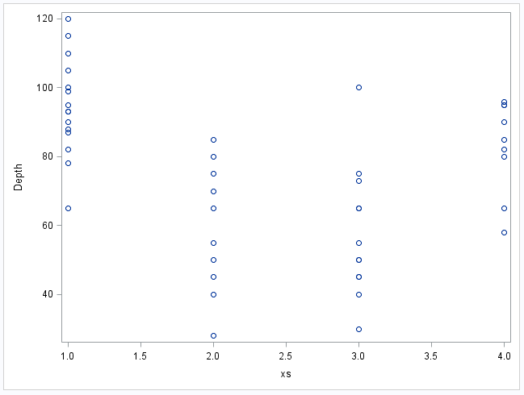
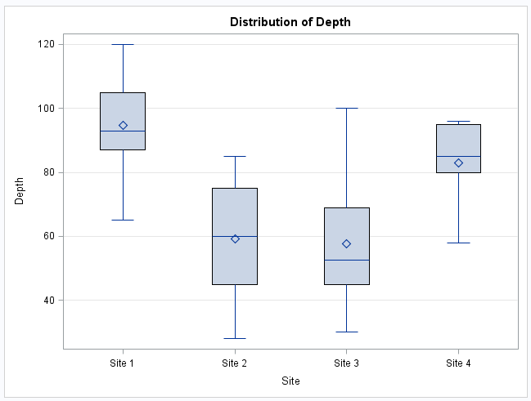
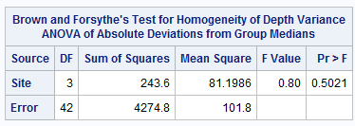
Archeology Example Assumptions: Homogeneity (Equal SD)
proc glm data = archeology; class site; model depth = site; means site / HOVTEST = BF t; run;

Slide 6
Archeology Example Assumption: Independence
The discovered artifacts associated with the depths were randomly selected from the log (book of recordings … not logarithms!) of discoveries.
Since the artifacts and, thus, the depths are associated with completely different sites, it is assumed that the data are independent between sites.

Slide 7
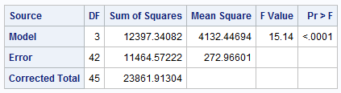
First Ask: Is there reason to believe any of them are different?
H₀: The mean depths of the artifacts are equal for each of the sites.
H_{A}: At least one pair of sites have different mean depths
There is strong evidence to suggest that at the alpha = .05 level of significance (p-value < .0001 from an ANOVA) that at least 2 of the sites have different mean depths.

Slide 8
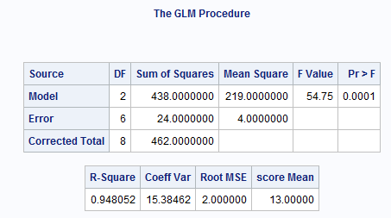
Archeology Example 6 Steps for ANOVA F Test (diff means)
1.
H₀: µ₁= µ₂ = µ₃ (Equal Means Model)
H_{a}: At least 1 pair are different (Separate Means Model)
2.
Critical value: F statistic with numGroups -1 and N-numGroups d.f. at alpha = 0.05
3.
F statistic = 54.75
proc glm data = archeology; class site; model depth = site; means site / HOVTEST = BF t; run;
4.
P-value = .0001
5.
Reject H₀.
6.
The evidence suggests that at least 1 pair of the group means are different. (P-value < .0001 from an ANOVA.)

Slide 9
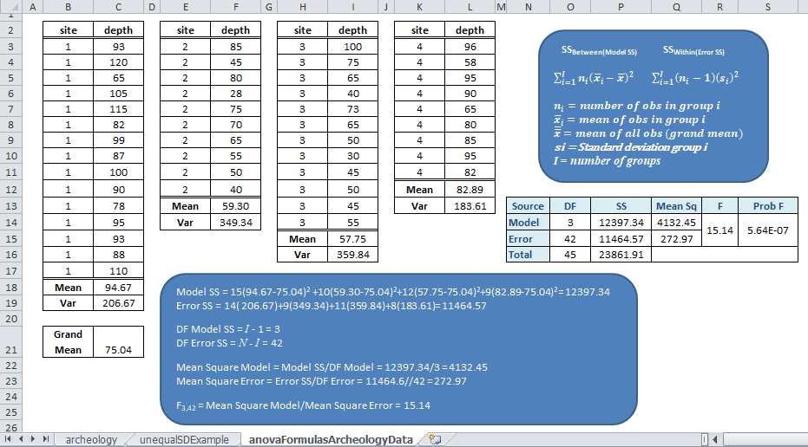
Archeology Example ANOVA Formulas

Slide 10
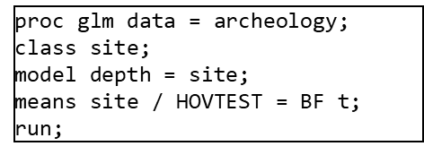
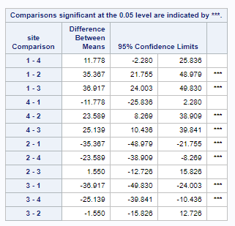
Now Look for Differences Between Group Using t-Statistic

Slide 11
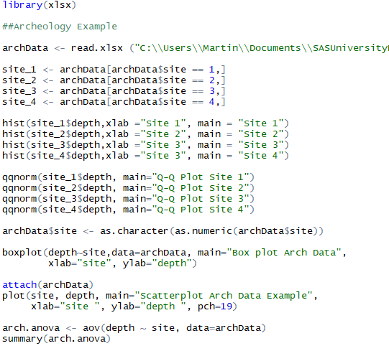
SAS and R Code for Archeology Example

Slide 12
Unequal Standard Deviations in Groups (You need this for the homework)
Assumption violated
Visual Tests
Box pots
Scatter plots
Brown and Forsythe's Test for Homogeneity of Variances
Non-parametric group means test:
Kruskill-Wallis Test
Parametric group means test:
Welch Test

Slide 13
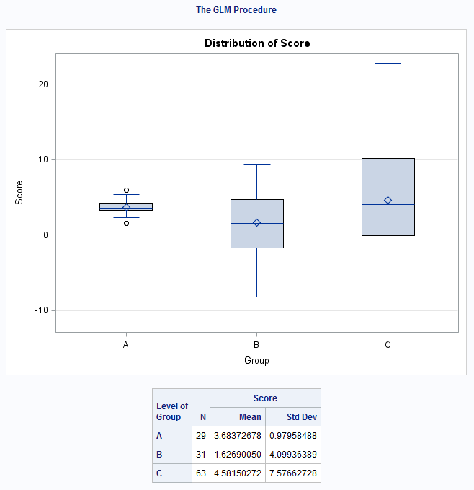
Unequal SD Example: Data, Means, StdDev, Boxplot
More obs for C
Level of group | N | score
 |  | Mean | Std Dev
A | 29 | 3.89619924 | 0.85209553
B | 31 | 1.97744181 | 4.10639231
C | 63 | 4.87526737 | 7.04876351

Slide 14
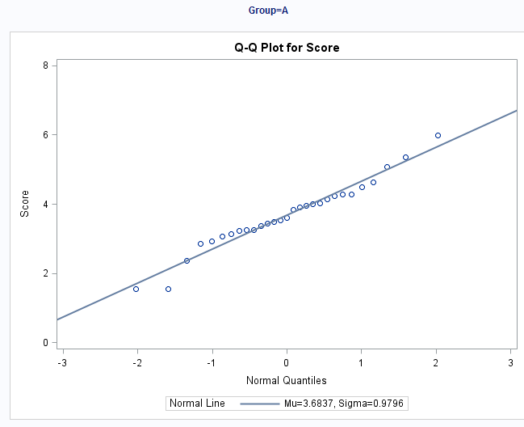
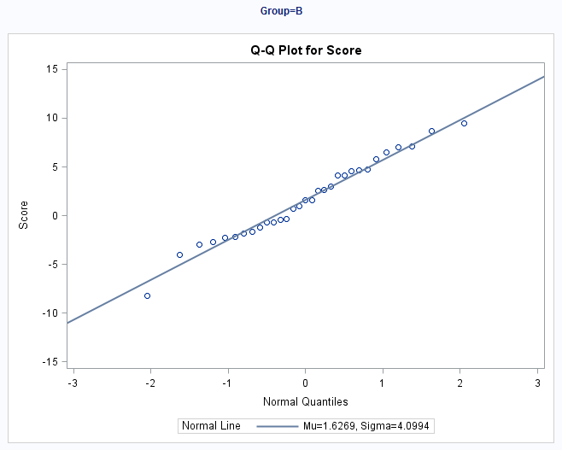
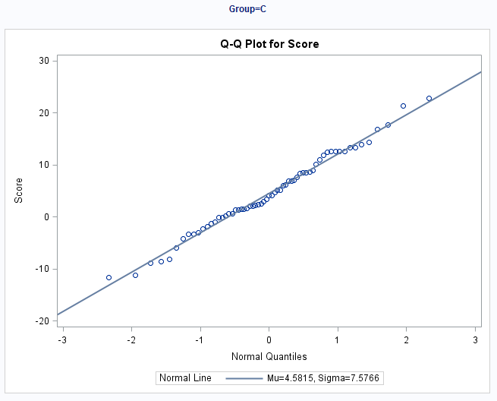
Normality Assumption
There is strong evidence in favor of these data coming from a normal distribution. We will proceed under this assumption.

Slide 15
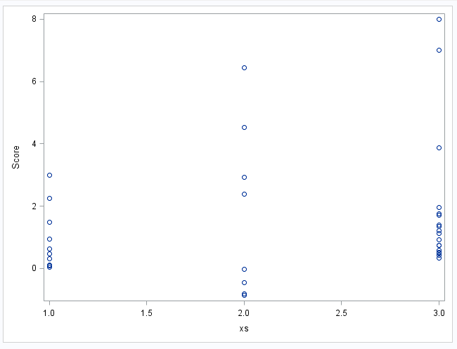
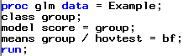
Unequal SD Example: Homogeneity of Variance Assumption
Brown and Forsythe's Test for Homogeneity of score Variance ANOVA of Absolute Deviations from Group Medians
Source | DF | Sum of Squares | Mean Square | F Value | Pr > F
group | 2 | 547.4 | 273.7 | 28.74 | <.0001
Error | 120 | 1142.6 | 9.5220
There is some evidence in support of these data coming from distributions with different standard deviations. If the standard deviation assumption is violated, what should we do?
.

Slide 16
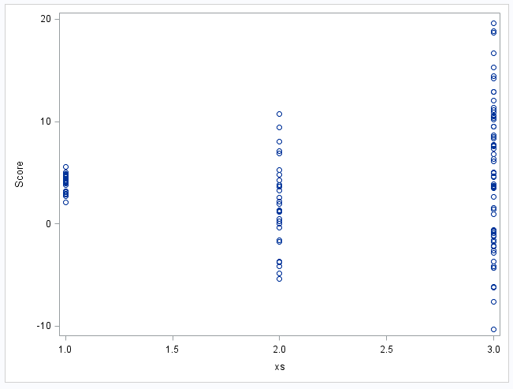
Unequal SD Example: Do not do ANOVA Assuming Equal SDs For Groups
Brown and Forsythe's Test for Homogeneity of score Variance ANOVA of Absolute Deviations from Group Medians
Source | DF | Sum of Squares | Mean Square | F Value | Pr > F
group | 2 | 547.4 | 273.7 | 28.74 | <.0001
Error | 120 | 1142.6 | 9.5220
There is strong evidence in support of these data coming from distributions with different standard deviations. Do not do ANOVA assuming equal SDs for groups. We will proceed under this assumption and run the Welch’s ANOVA.
ANOVA Assuming Equal SDs For Groups
Source | DF | Sum of Squares | Mean Square | F Value | Pr > F
Model | 2 | 174.481376 | 87.240688 | 2.90 | 0.0587
Error | 120 | 3606.677758 | 30.055648
Corrected Total | 122 | 3781.159135

Slide 17
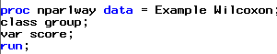
Unequal SD Example: Welch's ANOVA and Kruskal-Wallis Test
Welch's ANOVA for score
Source | DF | F Value | Pr > F
group | 2.0000 | 3.89 | 0.0261
Error | 58.0646
Kruskal-Wallis Test
Chi-Square | DF | Pr > ChiSq
6.2692 | 2 | 0.0435
There is sufficient evidence at the alpha = .05 level of significance (p-value = .3766 from Kruskal-Wallis Test) to suggest that at least two of the medians are different.
Notice that each test rejected their respective H_{o}. The point isn’t so much that one test will reject when the other will fail to reject. We must remember that as statisticians, we don’t personally favor one outcome over the other. We just want the appropriate test: the one with the most power. Kruskal-Wallis Test is the appropriate test.

Slide 18
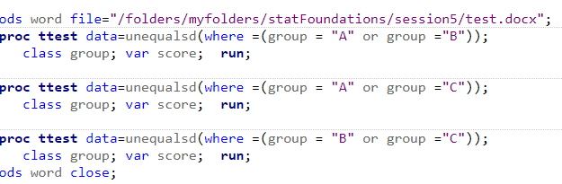
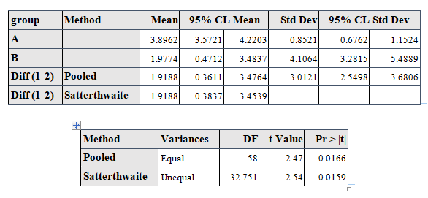
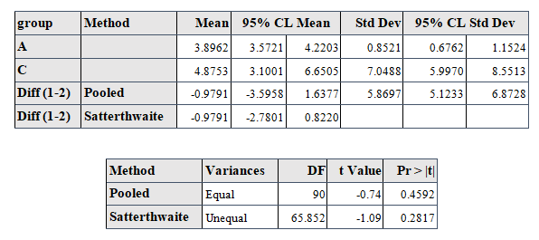
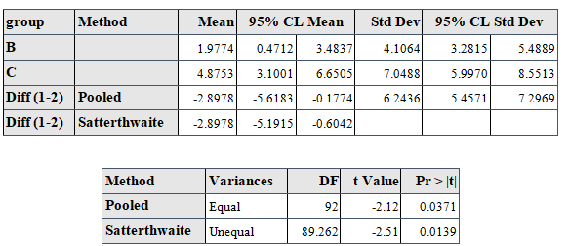
Conduct Welch T Tests to Evaluate Differences Between Groups

Slide 19
SAS and R Code Unequal Example
See also slide 19

Slide 20
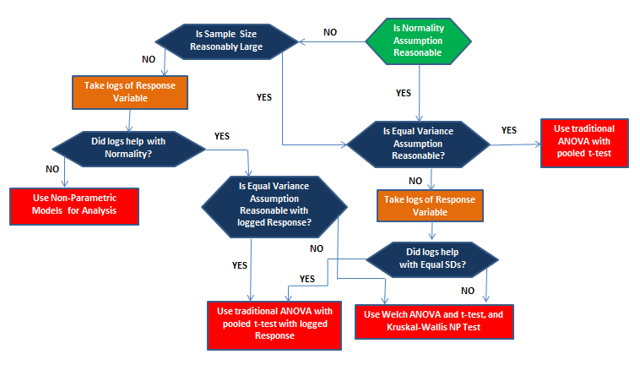
Flowchart for Analyzing Continuous Response and Categorical Variables with ANOVA

Slide 21
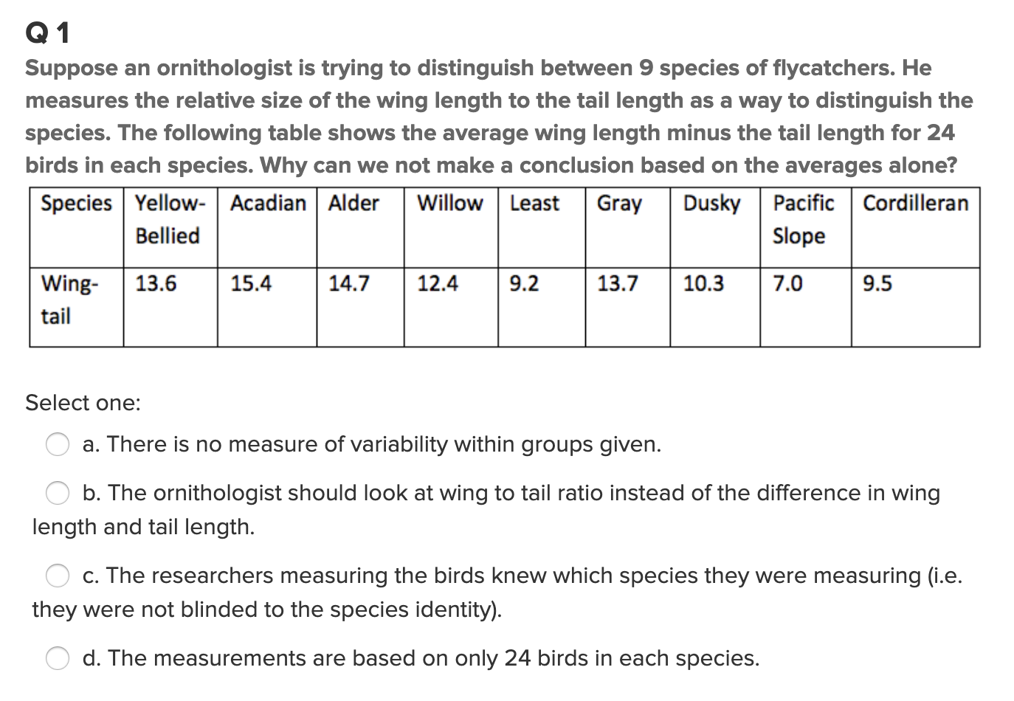
Quick Quiz Question 1 (<15 min)
Answer: a

Slide 22
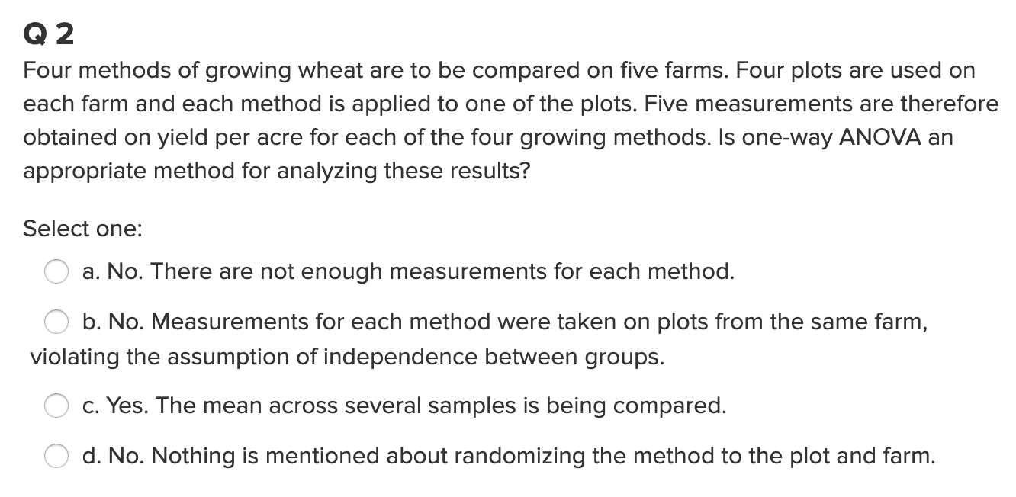
Quick Quiz Question 2 (< 15 min)
Answer: b

Slide 23
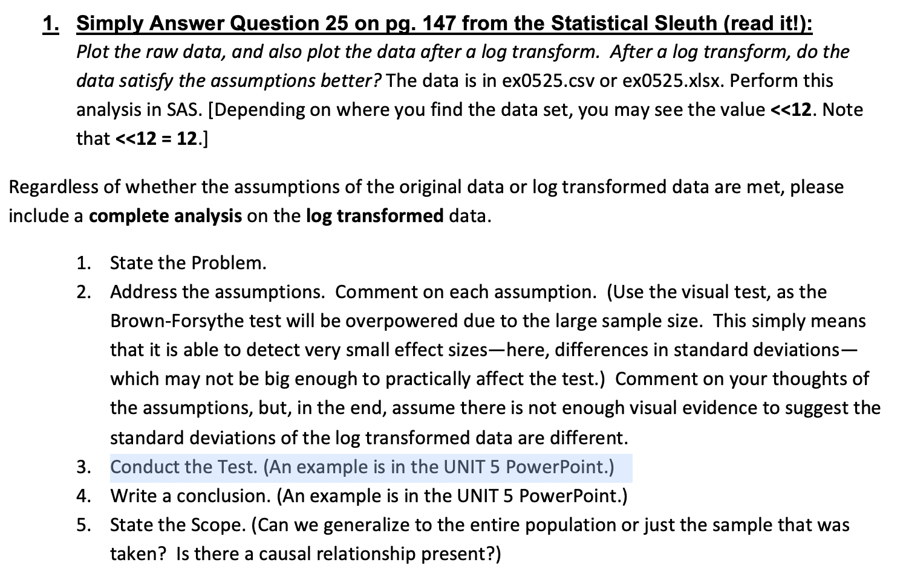
Question 1 ( < 2 hours )
Also, in Session5Data.xlsx

Slide 24
Question 1
Problem: How strong is the evidence that at least one of the five population distributions of education level has a different mean income than any of the others?
Assumptions: The income of each education has a normal distribution. Variances of normal distribution are equal and data is independent.
Normality: The histograms and QQ plots below show evidence of right skew. It is evidence against the normal distribution

Slide 25
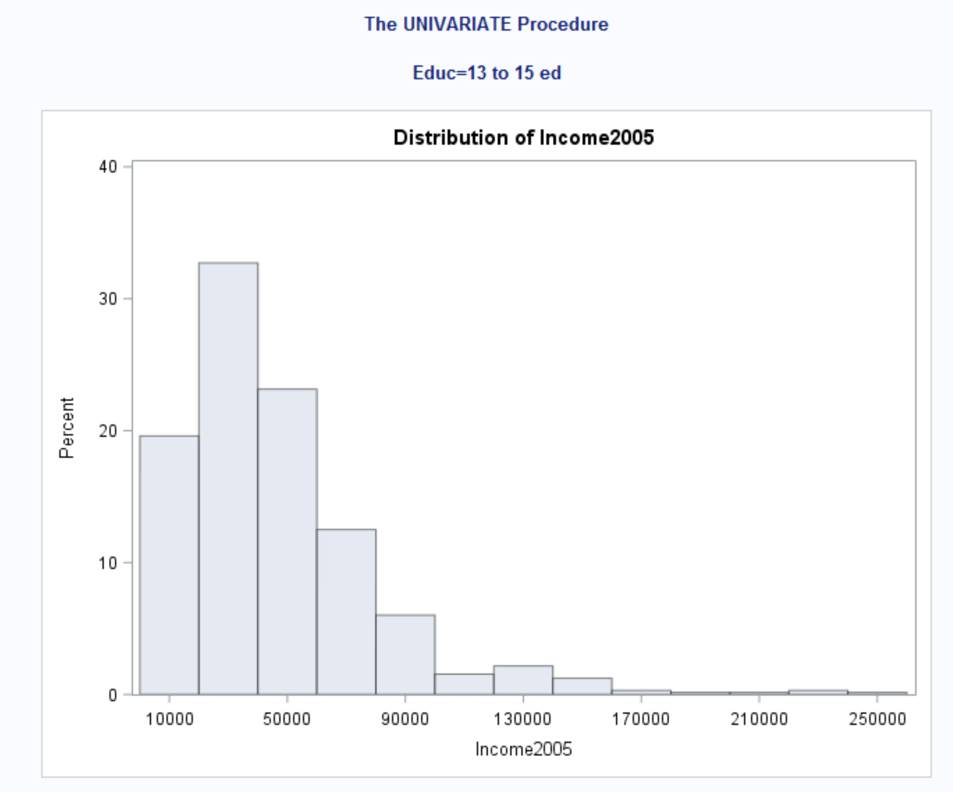
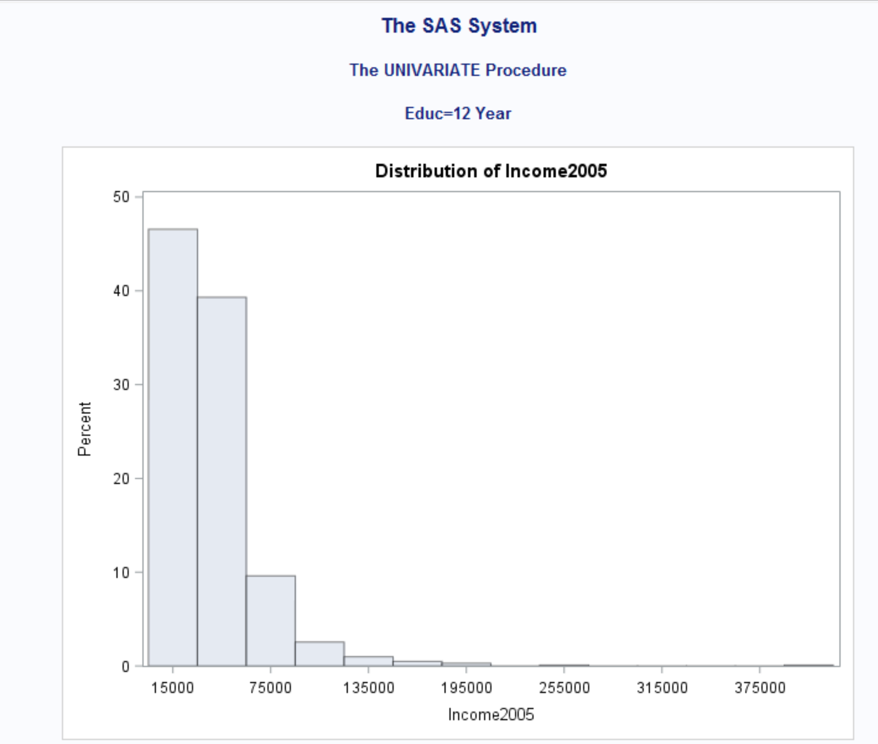
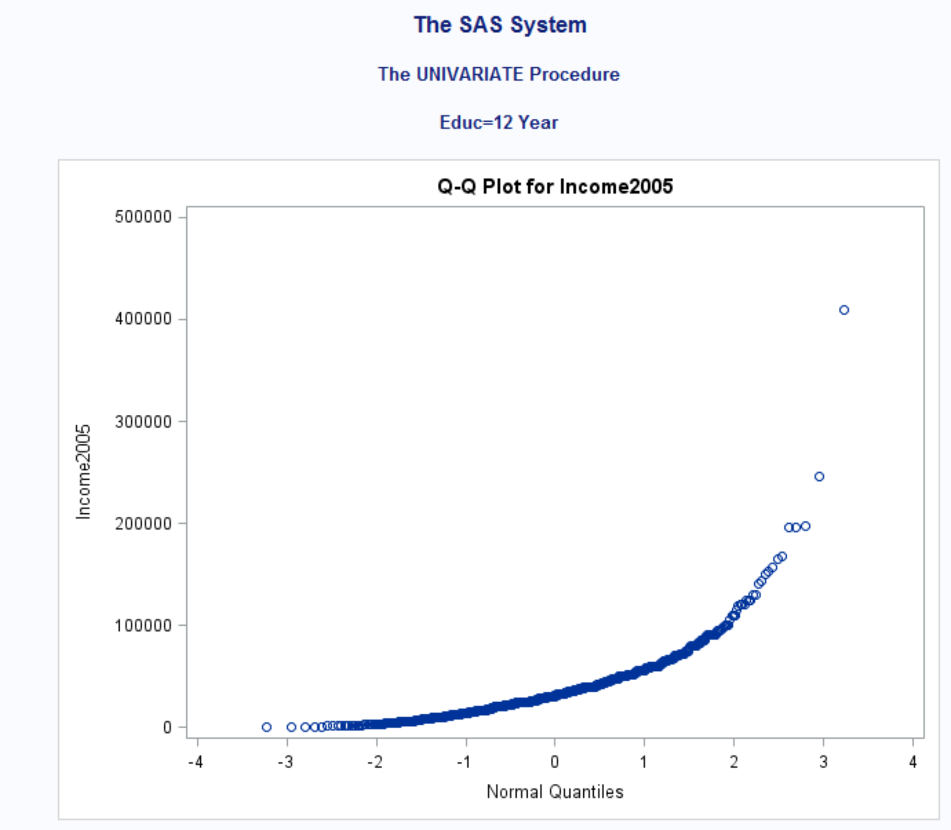
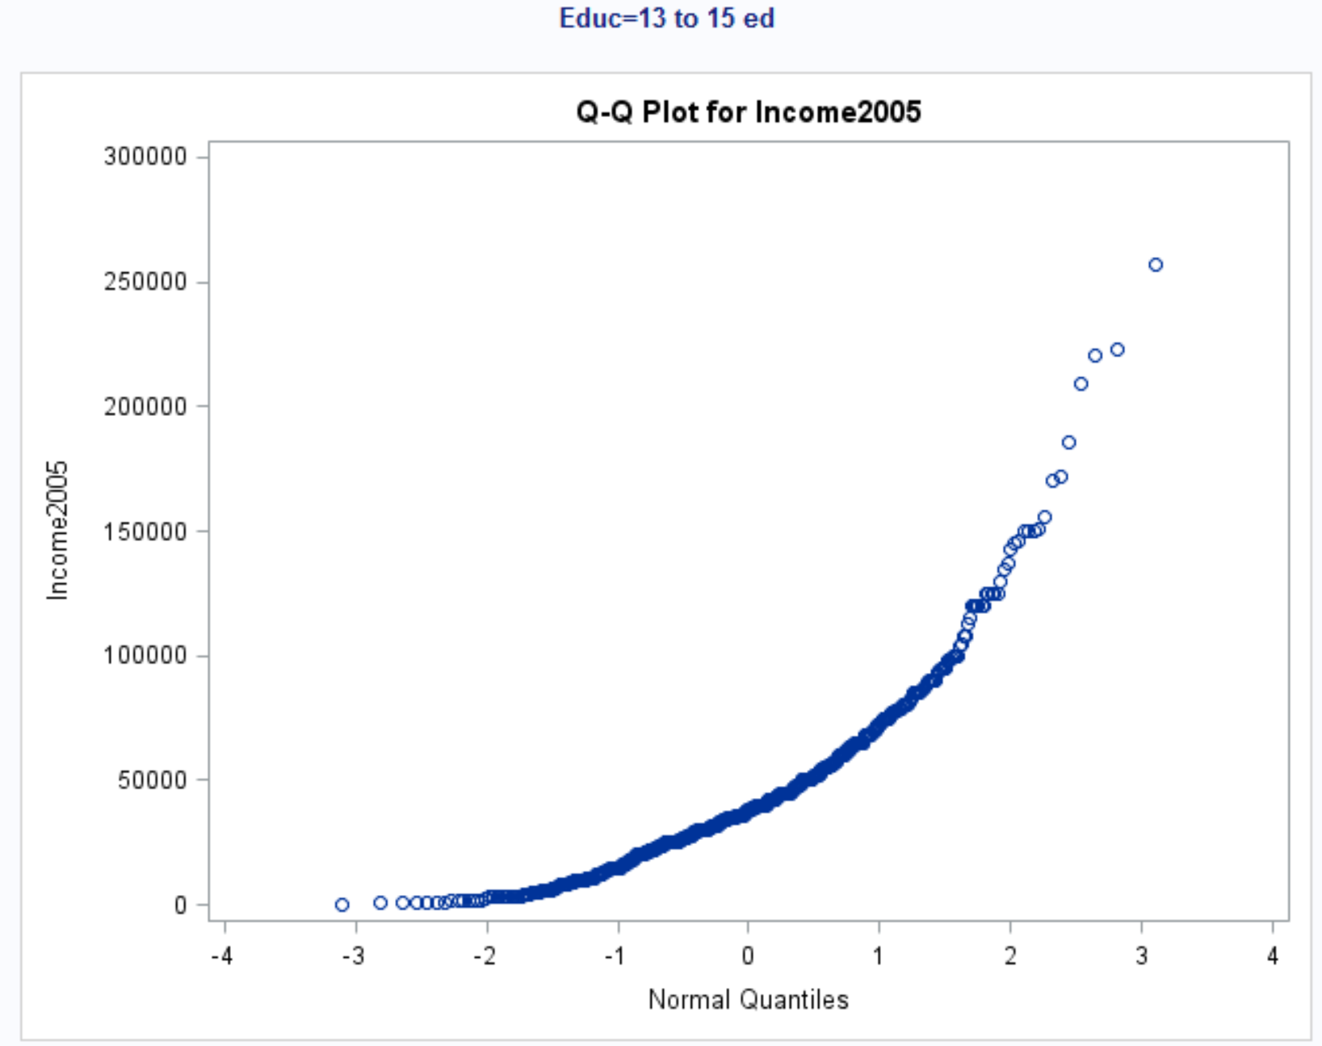

Slide 26
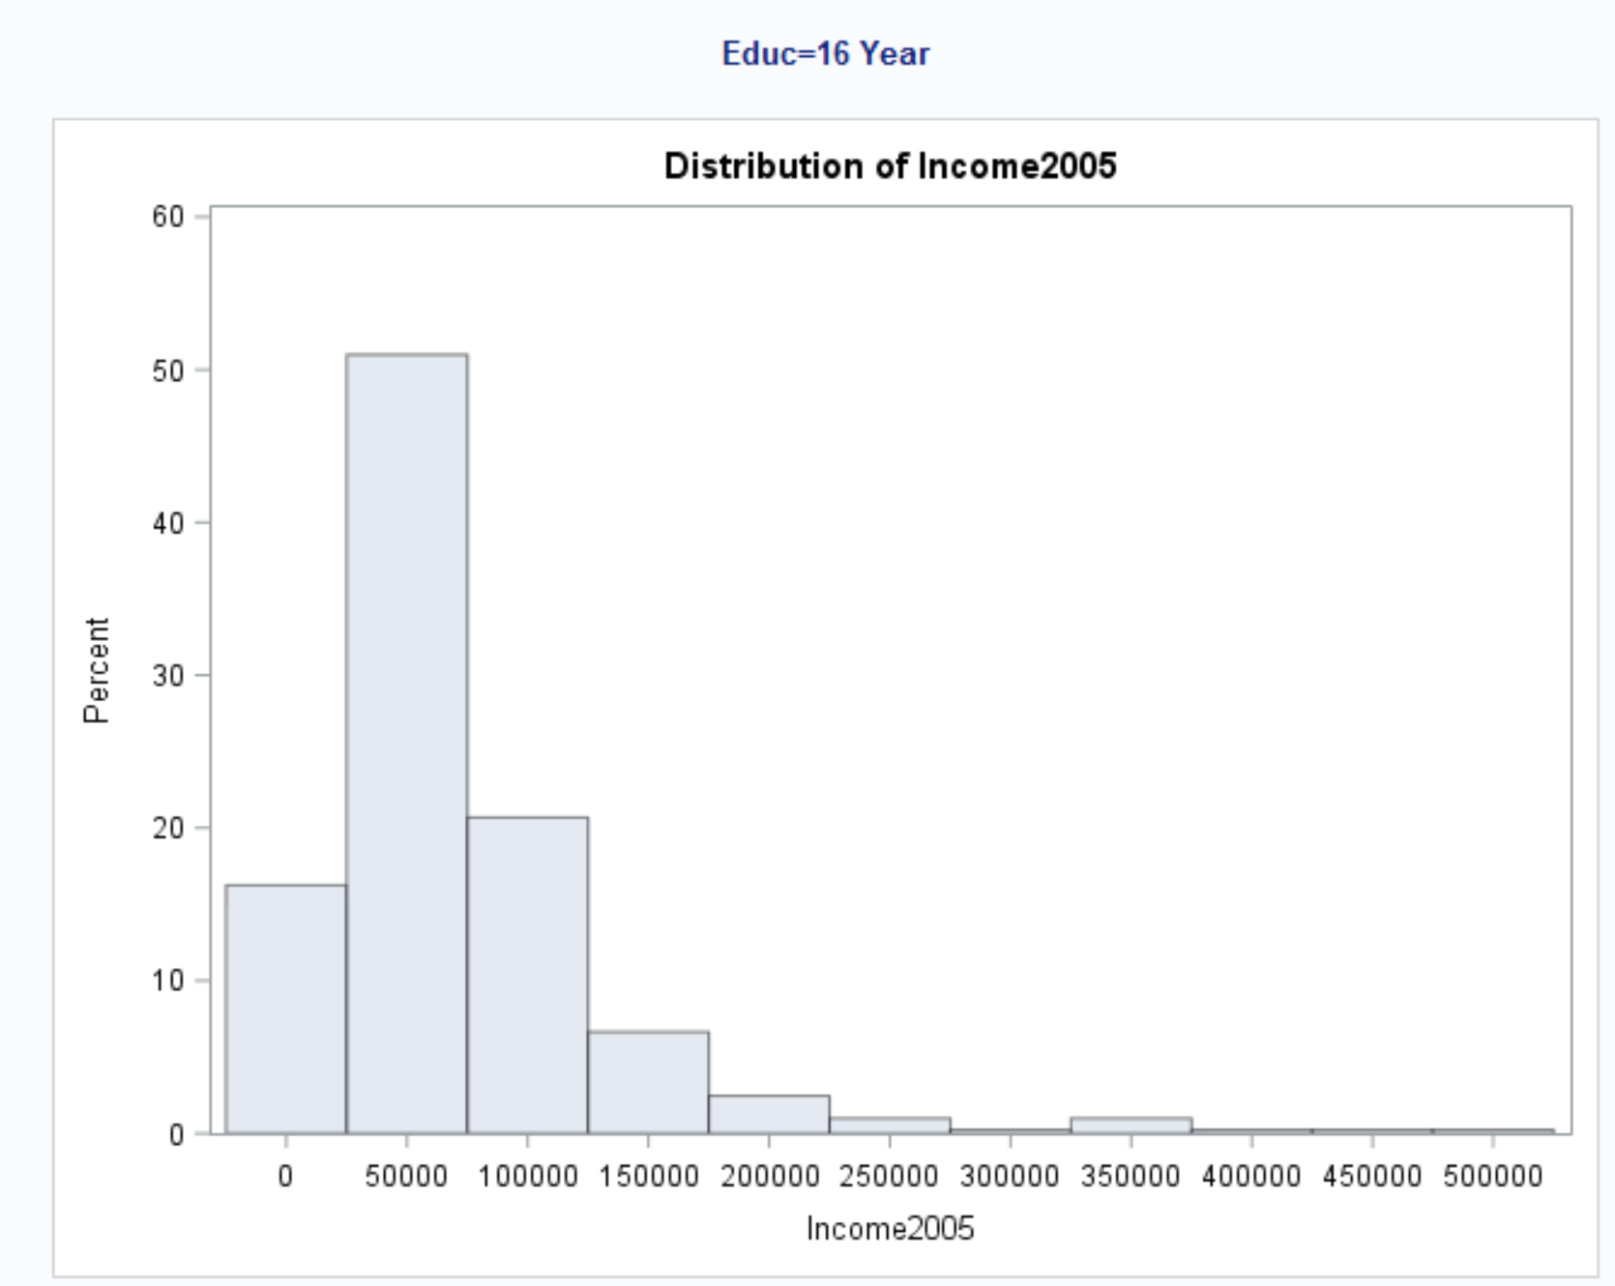
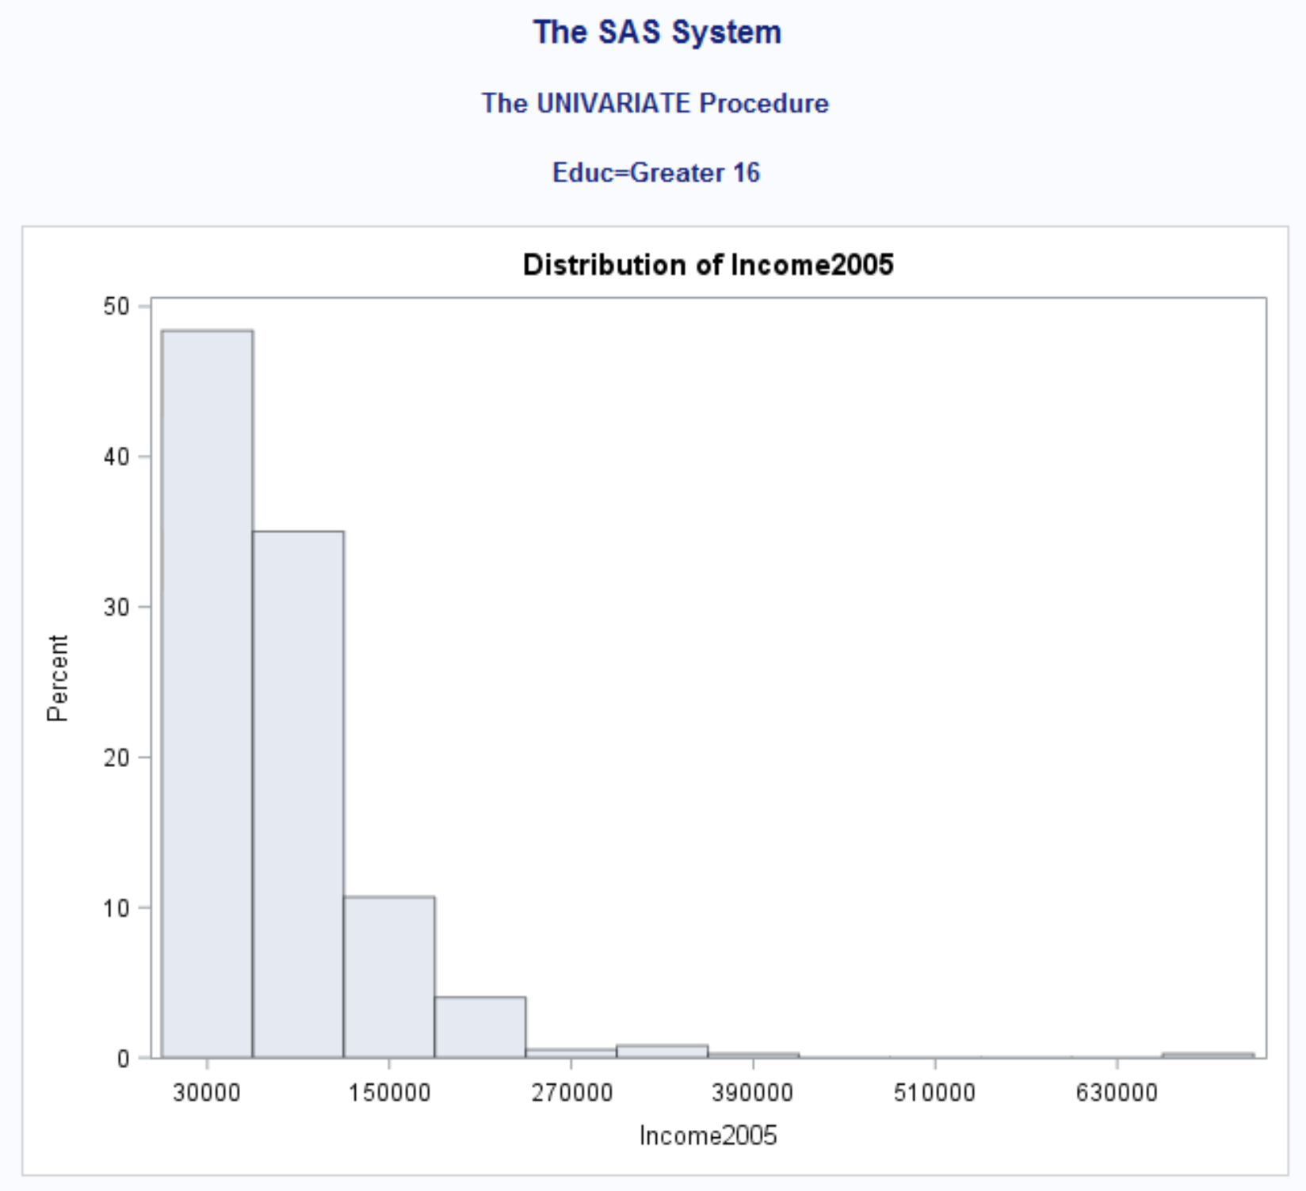
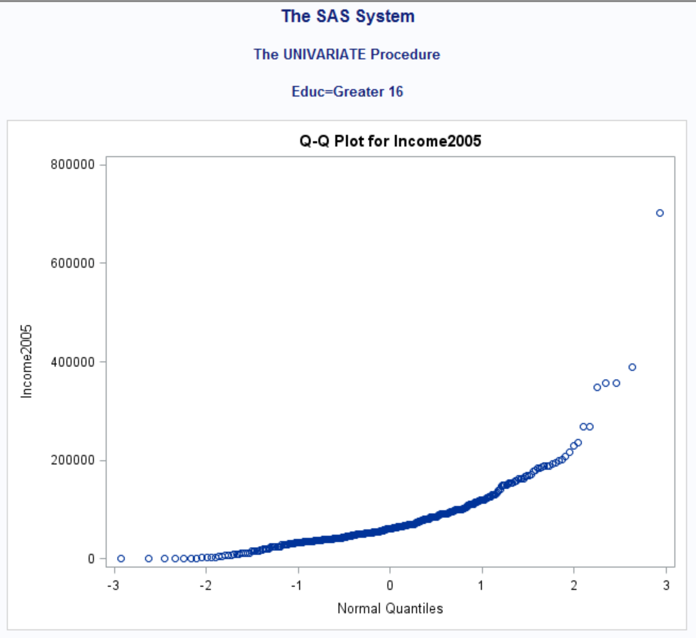
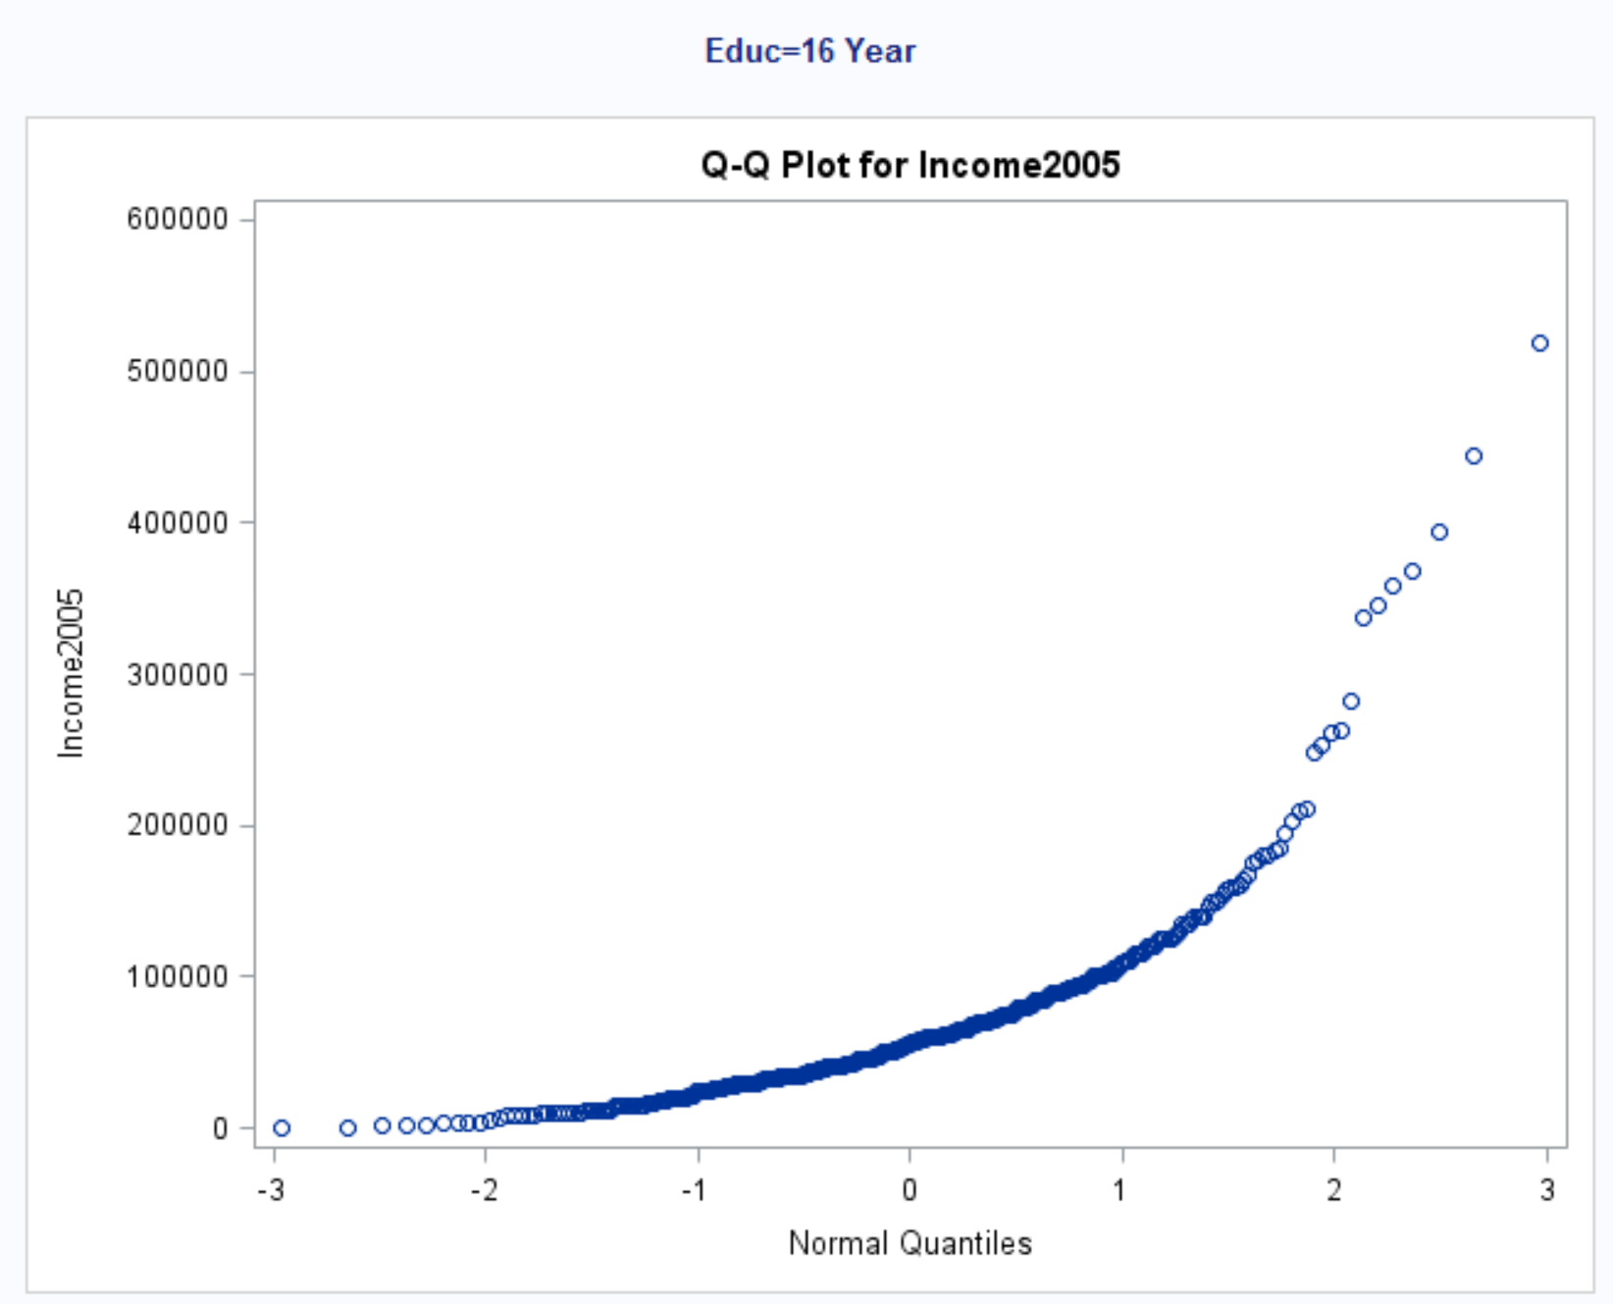

Slide 27
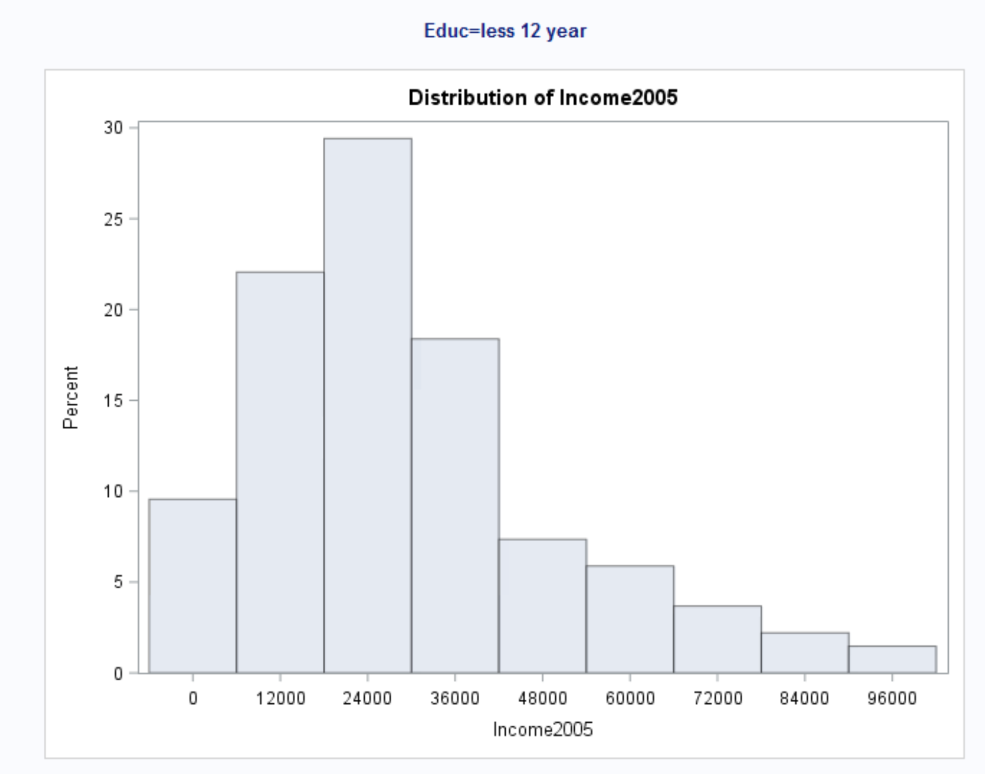
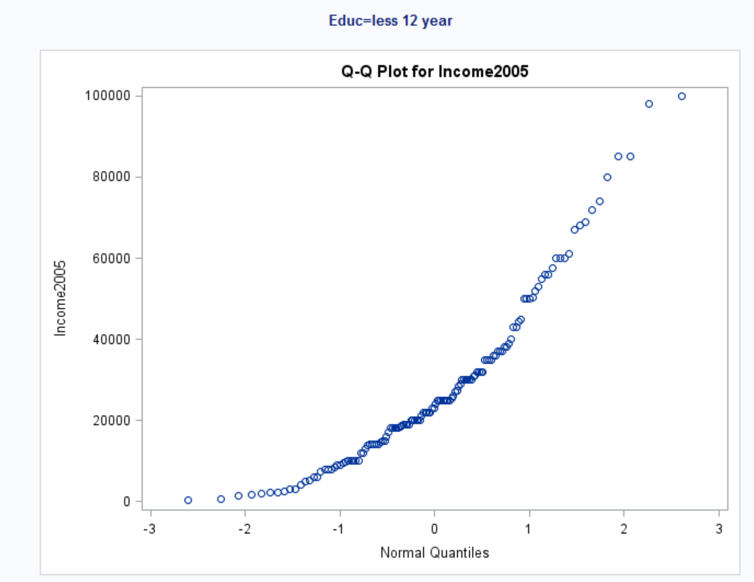

Slide 28
Scope of inference
This is an observational study so we cannot assign causal inference relationship.

Slide 29
Equal Standard Deviations
There are small deviations in the scatter plot and seems to have evidence against equal standard deviations.

Slide 30
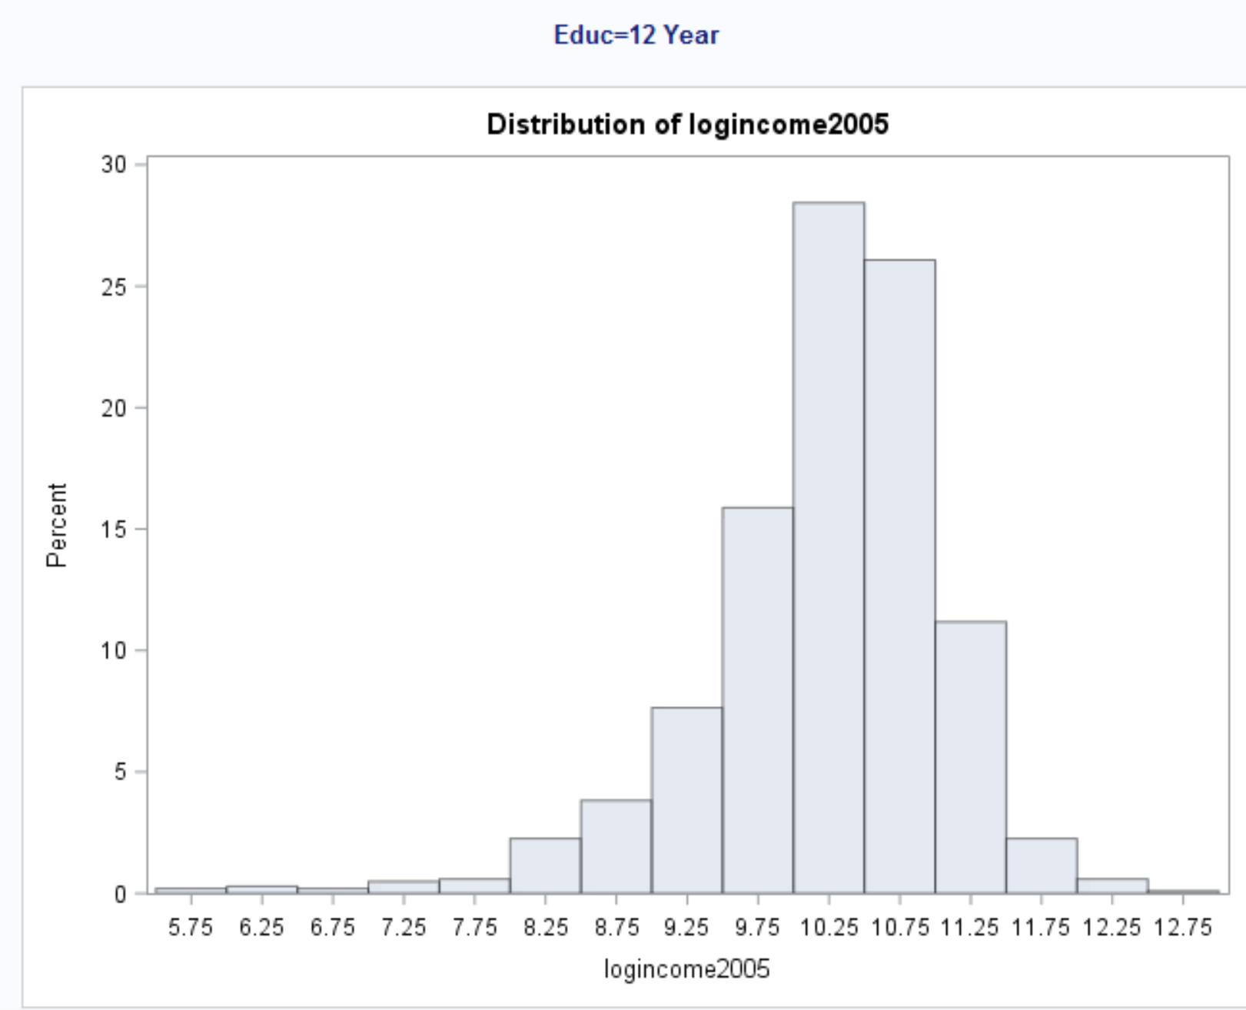
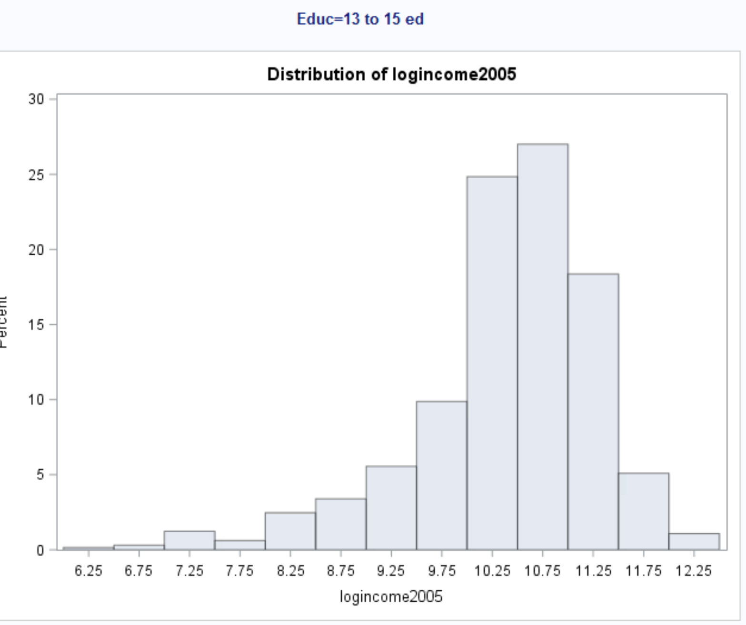
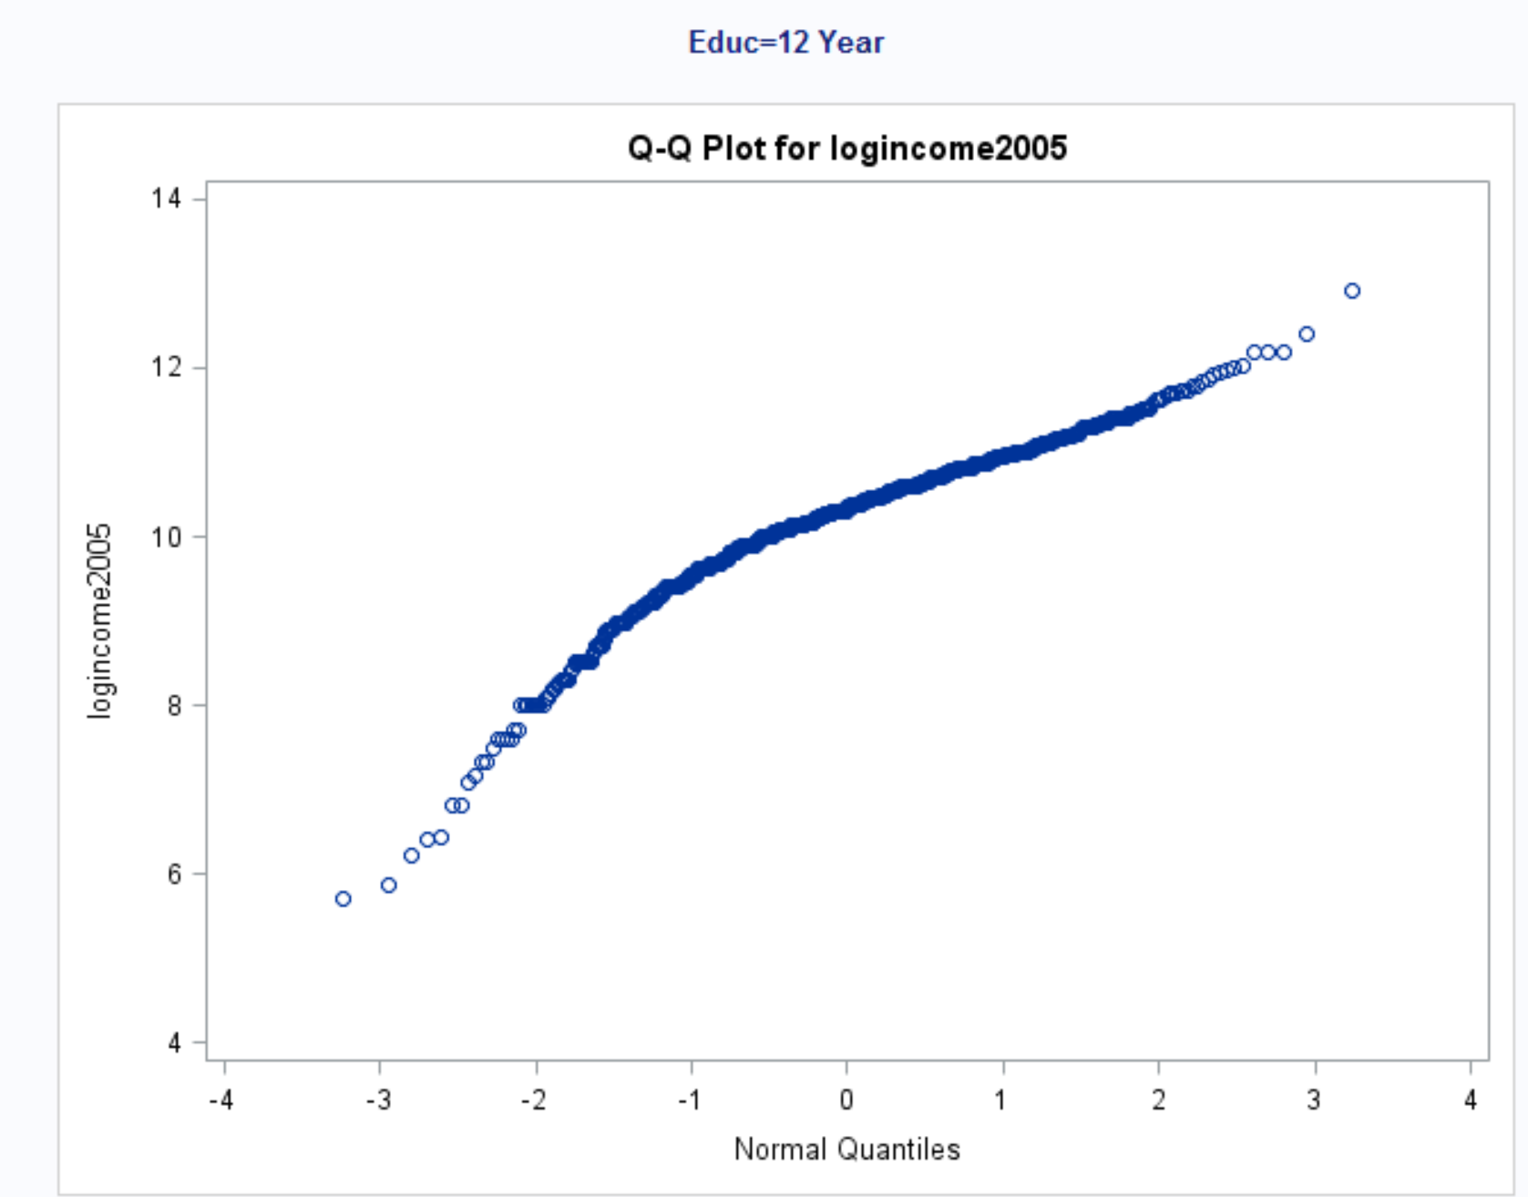
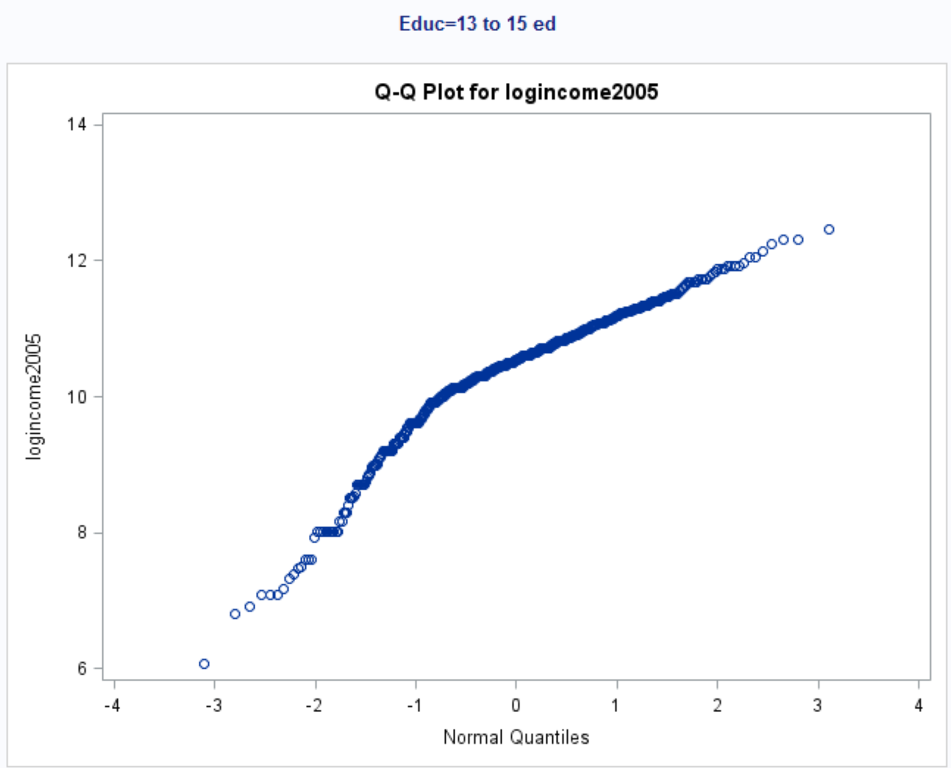

Slide 31
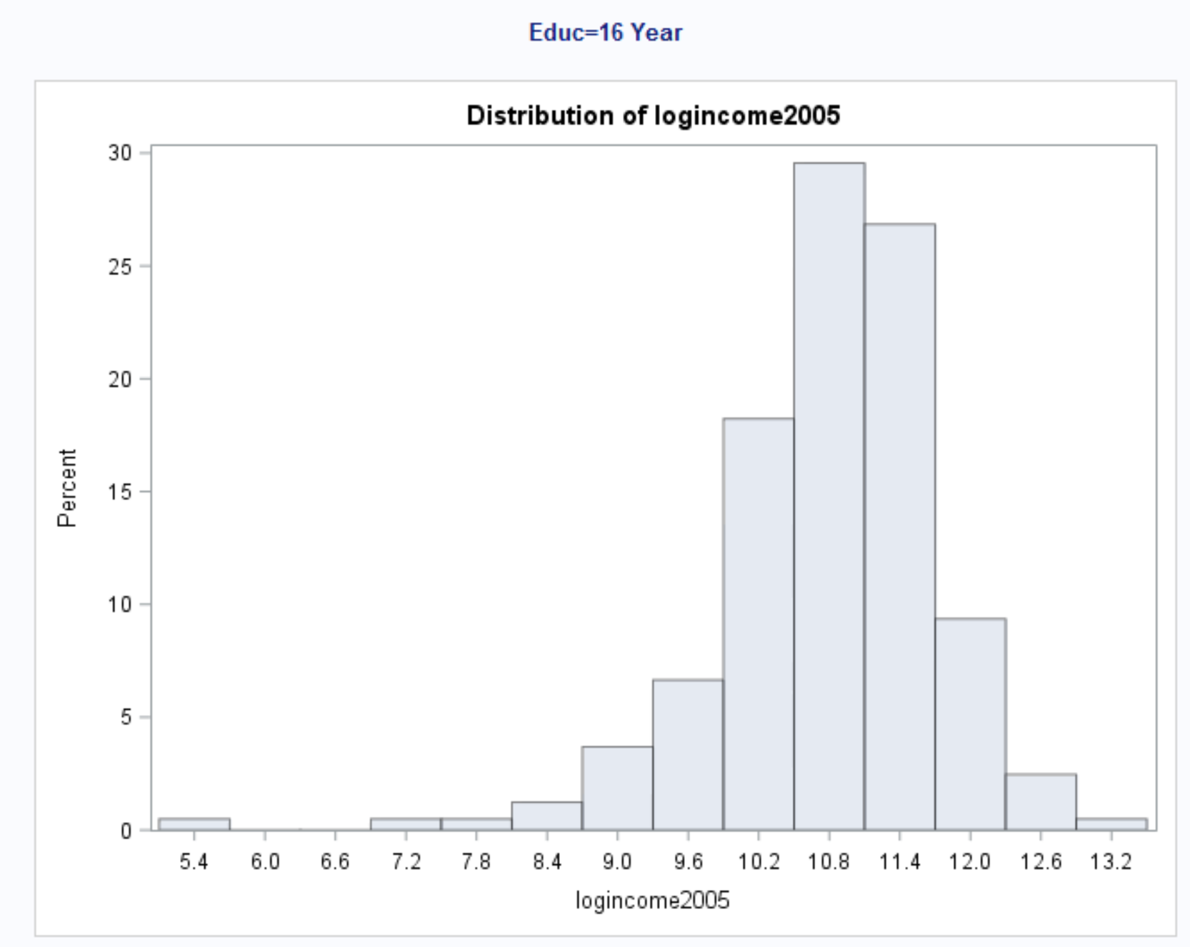
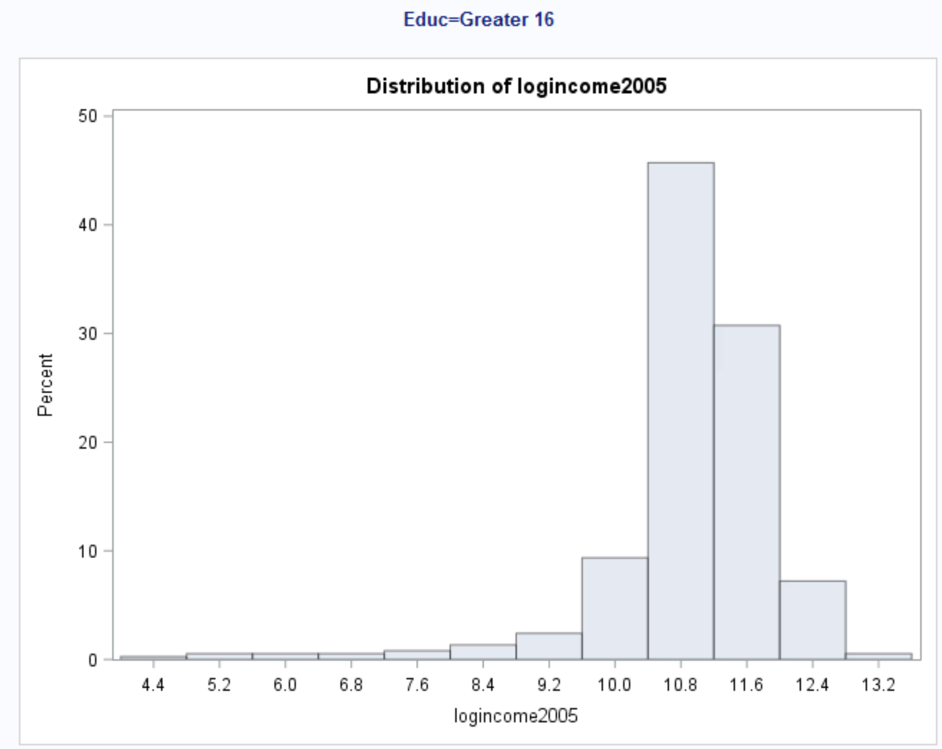
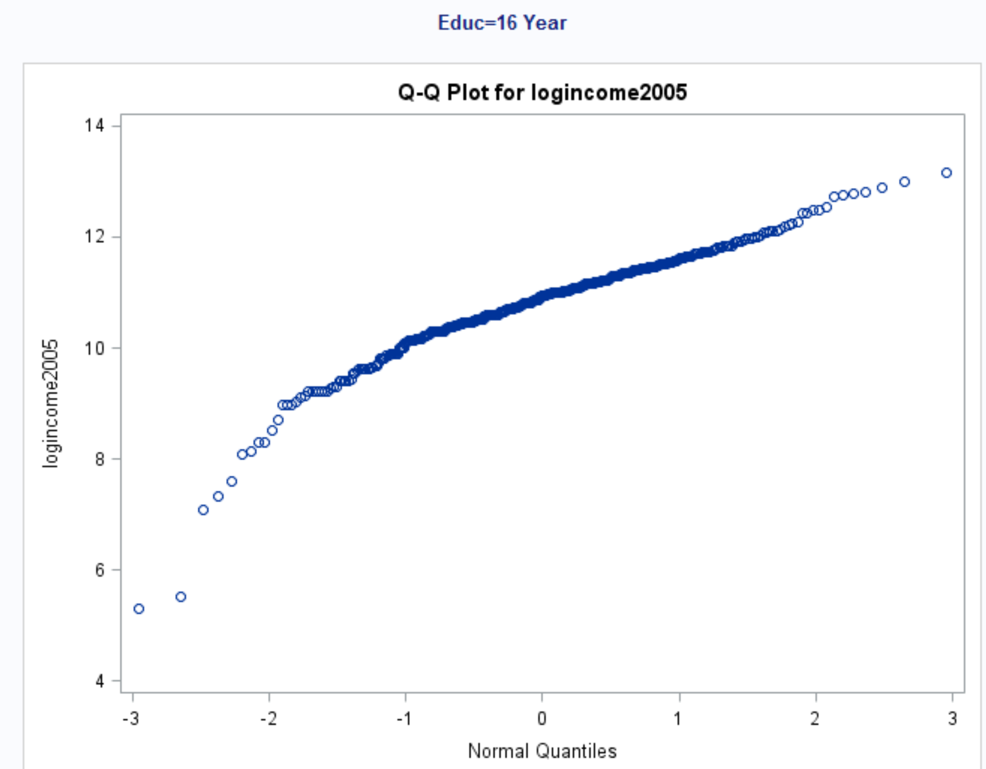
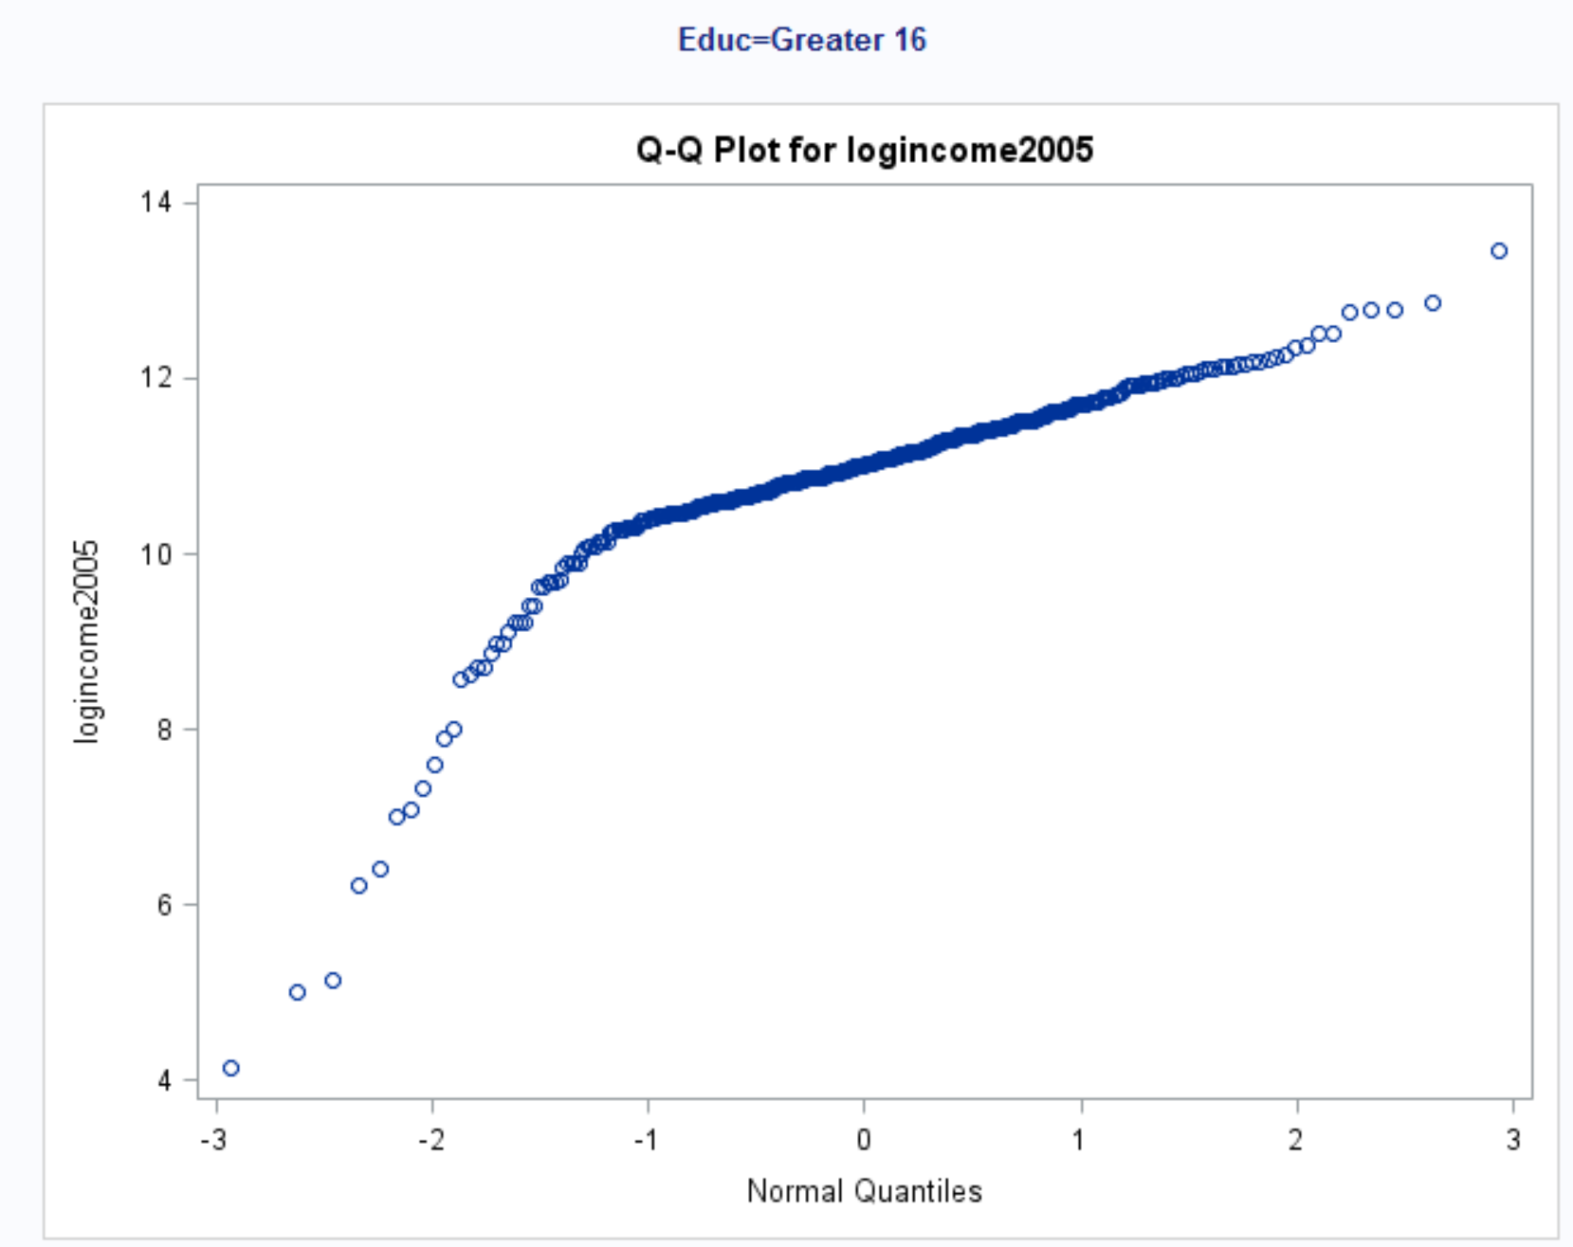

Slide 32
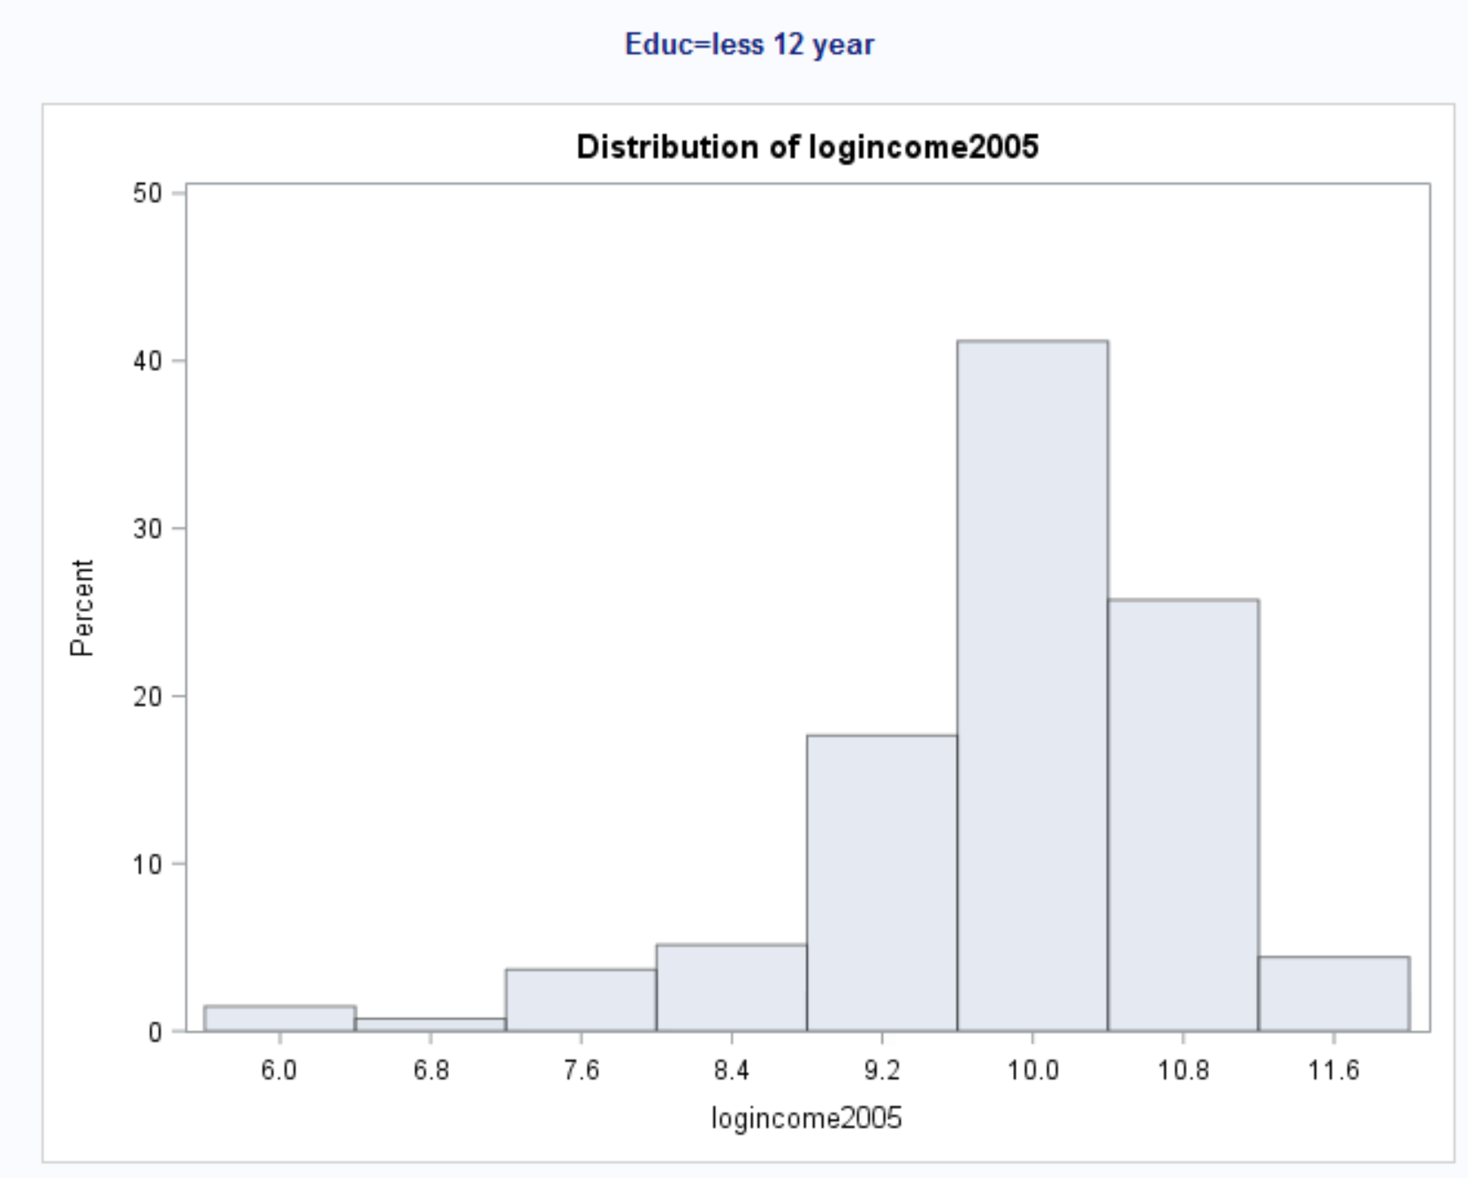
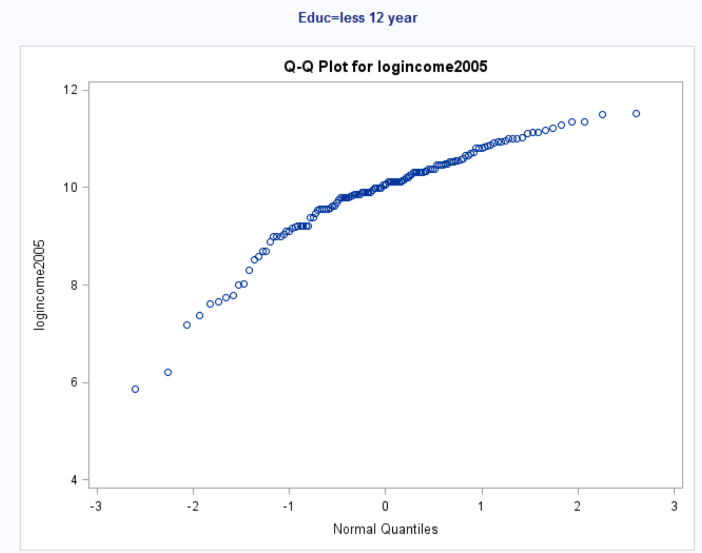

Slide 33
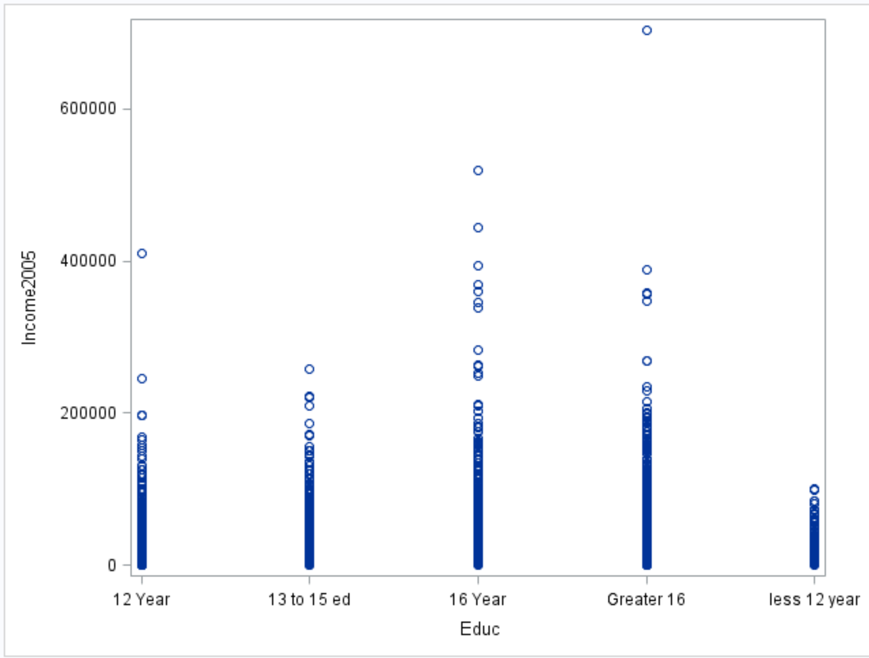

Slide 34


Slide 35
Independence
We can assume that data is independent. Between groups and within groups. We will do ANOVA test on medians.

Slide 36

ANOVA test

Slide 37
Step 1 Hypothesis
Ho: All median incomes are same for educations
Ha: At least one is different income median between eduations.
Step 2: identify test statistic
62.87

Slide 38
Step 4 p value
P = 0.0001
Step 5 Reject or accept null hypothesis
Reject null hypothesis
Step 6 Conclusion:
There is enough evidence to suggest that median incomes is different between education levels.

Slide 39
Takeaways and Questions (1 hour)
Please remember to record you takeways and any questions you may have!
I learned about ANOVA testing and median testing.
I think I got better at understanding the RANK sum testing.

